Slide 1
Apple Retail Sales & Warranty Analysis
A Comprehensive SQL Data Project

Slide 2
Data Tables Description :
• SALES:
Transaction records (sale_id, sale_date, store_id, product_id, quantity).
• CATEGORY:
Product groups (category_id, category_name).
• PRODUCTS:
Item details (product_id, product_name, category_id, price).
• STORES:
Location data (store_id, store_name, city, country).
• WARRANTY:
Claim records (claim_id, claim_date, sale_id, repair_status).

Slide 3
Key Focus Areas:
- Revenue, Growth Rate, Seasonality (Sales & Revenue)
- Quality, Claims, Product Life Cycle (Warranty & Product)
- Store Ranking, Claim Ratio, Diversity (Store Performance)
GOAL & FOCUS:
Project Goal:
- Analyse sales, product quality, and store performance using relational SQL queries.

Slide 4
1. Data Acquisition:
- Initial schema review of 5 core tables (category, products, sales, stores, warranty).
PROCESSES CONDUCTED:
2. Data Cleaning & Validation: (CRITICAL STEP)
- Confirmed NO NULL values in primary/critical columns.
- Confirmed NO DUPLICATE rows across all primary keys.
3. Analysis & Transformation:
- Utilized JOINs to link transactional, product, and location data.
- Employed Window Functions (LAG, RANK) for time-series and comparative analysis.
- Applied Aggregation (SUM, AVG, COUNT) for key metrics (Revenue, Claims, Sales).

Slide 5
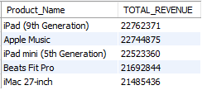
01. Find the top 5 products that generated the highest revenue in the last year.
SQL Query:
SELECT products.Product_Name, SUM(sales.quantity * products.Price) AS TOTAL_REVENUE
FROM products JOIN sales ON products.Product_ID = sales.product_id
WHERE sales.sale_date >= DATE_SUB(CURDATE(), INTERVAL 1 YEAR)
GROUP BY products.Product_Name ORDER BY TOTAL_REVENUE DESC LIMIT 5;
Observations:
This report highlights the top 5 revenue‑generating products in the latest sales year, showing key drivers of business performance.

Slide 6
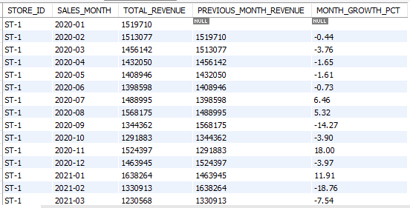
02. Calculate the monthly sales growth rate for each store.
SQL Query:
WITH MONTHLY_SALES AS (...), MONTH_GROWTH AS (...)
SELECT *, ROUND((100 * ((TOTAL_REVENUE - PREVIOUS_MONTH_REVENUE) / PREVIOUS_MONTH_REVENUE)),2) AS MONTH_GROWTH_PCT
FROM MONTH_GROWTH;
Observations:
This report tracks month‑over‑month revenue growth for each store, showing which locations are accelerating fastest.

Slide 7
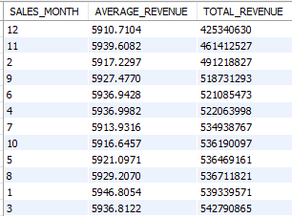
03. Identify the seasonal trends in product sales (e.g., peak months).
SQL Query:
SELECT MONTH(sales.sale_date) AS SALES_MONTH, AVG(sales.quantity * products.Price) AS AVERAGE_REVENUE,
SUM(sales.quantity * products.Price) AS TOTAL_REVENUE
FROM sales JOIN products ON sales.product_id = products.Product_ID
GROUP BY SALES_MONTH ORDER BY TOTAL_REVENUE DESC;
Observations:
This report shows monthly sales trends, highlighting which months generate the highest revenue and average earnings.

Slide 8
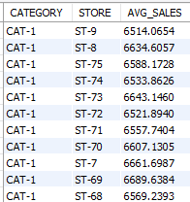
04. Find the average selling price per category and compare across stores.
SQL Query:
SELECT products.Category_ID AS CATEGORY, sales.store_id AS STORE,
AVG(sales.quantity * products.Price) AS AVG_SALES
FROM SALES JOIN products ON sales.product_id = products.Product_ID
GROUP BY CATEGORY, STORE ORDER BY CATEGORY, STORE DESC;
Observations:
This report shows the average sales value by category and store, helping identify which product groups perform best in each location.

Slide 9
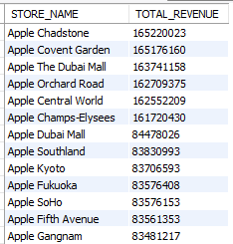
05. Determine the most profitable store based on total revenue.
SQL Query:
SELECT stores.Store_Name AS STORE_NAME, SUM(sales.quantity * products.Price ) AS TOTAL_REVENUE
FROM sales JOIN products ON sales.product_id = products.Product_ID
JOIN stores ON sales.store_id = stores.Store_ID
GROUP BY STORE_NAME ORDER BY TOTAL_REVENUE DESC;
Observations:
This report ranks stores by total revenue, highlighting the top performers driving the highest sales.

Slide 10
06. List products that have never been sold since their launch.
nil
SQL Query:
SELECT products.Product_Name FROM products LEFT JOIN sales
ON products.Product_ID = sales.product_id
WHERE sales.product_id IS NULL;
Observations:
This report highlights products with zero sales, signaling items that may need promotion or removal.

Slide 11
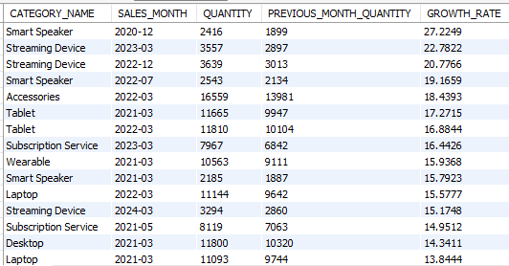
07. Find the fastest-growing category in terms of sales quantity.
SQL Query:
WITH SALES_DETAILS AS (...), GROWTH_DETAILS AS (...)
SELECT *, ( 100 * (QUANTITY - PREVIOUS_MONTH_QUANTITY) / PREVIOUS_MONTH_QUANTITY) AS GROWTH_RATE
FROM GROWTH_DETAILS ORDER BY GROWTH_RATE DESC;
Observations:
This report shows month‑over‑month growth by category, highlighting which product groups are surging fastest.

Slide 12
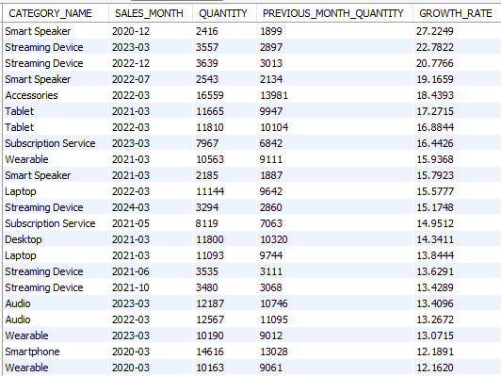
08. Identify products with high revenue with low sales quantity.
SQL Query:
WITH SALES_QTY AS (...), AVERAGES AS (...)
SELECT PRODUCT_ID, QTY, REVENUE FROM SALES_QTY CROSS JOIN AVERAGES
WHERE QTY < AVG_QTY AND REVENUE > AVG_REVENUE ORDER BY REVENUE;
Observations:
These products sell fewer units than average but generate higher revenue, showing strong premium demand.

Slide 13
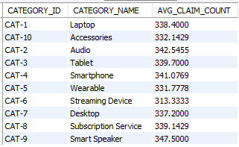
09. Compare the average warranty claims per category to spot quality issues.
SQL Query:
WITH CLAIM_DETAILS AS (...)
SELECT CLAIM_DETAILS.CATEGORY_ID, AVG(CLAIM_DETAILS.CLAIM_COUNT) AS AVG_CLAIM_COUNT
FROM CLAIM_DETAILS GROUP BY CATEGORY_ID, CATEGORY_NAME ORDER BY AVG_CLAIM_COUNT DESC;
Observations:
This report shows average warranty claims per category, highlighting which product groups face more issues.

Slide 14

10. Find the top 3 categories contributing to overall revenue.
SQL Query:
SELECT category.category_name AS CATEGORY_NAME, SUM(sales.quantity * products.Price) AS TOTAL_REVENUE
FROM sales JOIN products ON sales.product_id = products.Product_ID
JOIN category ON products.Category_ID = category.category_id
GROUP BY CATEGORY_NAME ORDER BY TOTAL_REVENUE DESC LIMIT 3;
Observations:
Top 3 categories generate the highest revenue, showing where customer demand and profit are strongest.

Slide 15
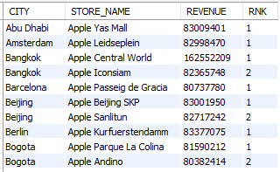
11. Rank stores by sales per city (City-level aggregation).
SQL Query:
SELECT stores.City AS CITY, stores.Store_Name AS STORE_NAME,
SUM(sales.quantity * products.Price) AS REVENUE,
RANK() OVER (PARTITION BY CITY ORDER BY SUM(sales.quantity * products.Price) DESC) AS RNK
FROM sales JOIN stores ON sales.store_id = stores.Store_ID
JOIN products ON sales.product_id = products.Product_ID GROUP BY CITY, STORE_NAME;
Observations:
This report ranks stores by revenue within each city. It highlights the top‑earning store in every location, showing where sales performance is strongest and guiding focus for growth in lower‑ranked stores

Slide 16
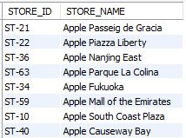
12. Find stores that sell high-value products but have low warranty claims.
SQL Query:
WITH HIGH_VALUE_PRODUCTS AS (...), STORE_LOW_CLAIM_COUNT AS (...)
SELECT DISTINCT COSTLY_SALES_STORE.STORE_ID, stores.Store_Name
FROM COSTLY_SALES_STORE INNER JOIN STORE_LOW_CLAIM_COUNT ON ...;
Observations:
These stores sell premium products yet maintain below‑average warranty claims, showing strong quality and customer trust.

Slide 17
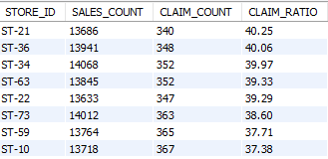
13. Identify stores with highest warranty claim ratio.
SQL Query:
WITH STORE_SALES_COUNT AS (...), STORE_CLAIM_COUNT AS (...)
SELECT DISTINCT sales.store_id, ROUND((STORE_SALES_COUNT.SALES_COUNT / STORE_CLAIM_COUNT.CLAIM_COUNT),2) AS CLAIM_RATIO
FROM STORE_SALES_COUNT JOIN STORE_CLAIM_COUNT ON ... ORDER BY CLAIM_RATIO DESC;
Observations:
This analysis highlights stores with the best sales-to-claim ratio. A higher ratio means more sales with fewer warranty issues — signalling stronger product quality and customer satisfaction. Stores with lower ratios may need closer attention to service, training, or supplier quality

Slide 18
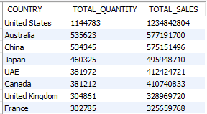
14. Compare sales performance across countries.
SQL Query:
SELECT stores.Country AS COUNTRY, SUM(sales.quantity) AS TOTAL_QUANTITY,
SUM(sales.quantity * products.Price) AS TOTAL_SALES
FROM sales JOIN products ON sales.product_id = products.Product_ID
JOIN stores ON sales.store_id = stores.Store_ID
GROUP BY COUNTRY ORDER BY TOTAL_SALES DESC;
Observations:
This report shows which countries drive the highest sales. Top‑performing regions generate the bulk of revenue, while lower‑ranking countries highlight growth opportunities.

Slide 19
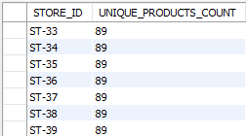
15. Find the store with maximum product diversity (unique products sold).
SQL Query:
SELECT sales.store_id AS STORE_ID, COUNT(DISTINCT sales.product_id) AS UNIQUE_PRODUCTS_COUNT
FROM sales GROUP BY STORE_ID ORDER BY UNIQUE_PRODUCTS_COUNT DESC;
Observations:
Stores with higher unique product counts are offering the widest variety, attracting more customers and boosting sales opportunities.

Slide 20

16. Find the average time gap between sale_date and claim_date.
SQL Query:
SELECT ROUND(AVG(DATEDIFF(warranty.claim_date, sales.sale_date)),2) AS AVG_GAP_DAYS,
ROUND(AVG((DATEDIFF(warranty.claim_date, sales.sale_date) / 30)),2) AS AVG_GAP_MONTHS
FROM warranty JOIN sales ON warranty.sale_id = sales.sale_id;
Observations:
On average, customers raise warranty claims around X days (≈ Y months) after purchase. This indicates the typical lifespan before issues arise.

Slide 21
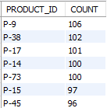
17. Identify products with highest repair_status = 'Pending' claims.
SQL Query:
SELECT sales.product_id AS PRODUCT_ID, COUNT(warranty.repair_status) AS COUNT
FROM warranty JOIN sales ON warranty.sale_id = sales.sale_id
WHERE warranty.repair_status = 'Pending' GROUP BY PRODUCT_ID ORDER BY COUNT DESC;
Observations:
This query identifies products with the highest number of pending warranty claims. Product 9 tops the list, indicating unresolved service issues.

Slide 22
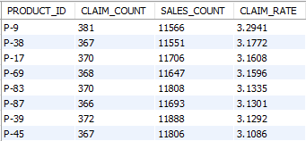
18. Calculate the claim rate per product (claims/sales).
SQL Query:
WITH PRODUCT_CLAIM_COUNT AS (...), PRODUCT_SALES_COUNT AS (...)
SELECT PRODUCT_CLAIM_COUNT.PRODUCT_ID, (CLAIM_COUNT / SALES_COUNT) * 100 AS CLAIM_RATE
FROM PRODUCT_CLAIM_COUNT LEFT JOIN PRODUCT_SALES_COUNT ON ... ORDER BY CLAIM_RATE DESC;
Observations:
This query identifies products with the highest warranty claim rate relative to sales. Product 9 has the worst performance, with rate of 3.29 of its sales resulting in claims.

Slide 23
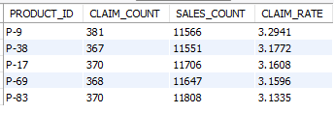
19. Find the top 5 products with the worst warranty performance.
SQL Query:
WITH PRODUCT_CLAIM_COUNT AS (...), PRODUCT_SALES_COUNT AS (...)
SELECT PRODUCT_CLAIM_COUNT.PRODUCT_ID, (CLAIM_COUNT / SALES_COUNT) * 100 AS CLAIM_RATE
FROM PRODUCT_CLAIM_COUNT LEFT JOIN PRODUCT_SALES_COUNT ON ... ORDER BY CLAIM_RATE DESC LIMIT 5;
Observations:
This query identifies the top 5 products with the worst warranty performance. Product 301 has a 30% claim rate, making it the most problematic.

Slide 24
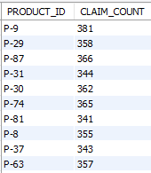
20. Find the high-value products with high warranty claims.
SQL Query:
WITH HIGH_VALUE_PRODUCTS AS (...), HIGH_CLAIM_PRODUCTS AS (...)
SELECT HIGH_VALUE_PRODUCTS.Product_ID
FROM HIGH_VALUE_PRODUCTS INNER JOIN HIGH_CLAIM_PRODUCTS ON ...;
Observations:
This query identifies premium products that also suffer from high warranty claims. These products represent a double risk: they are costly for customers but also unreliable.

Slide 25
Thank You

